Slide 1
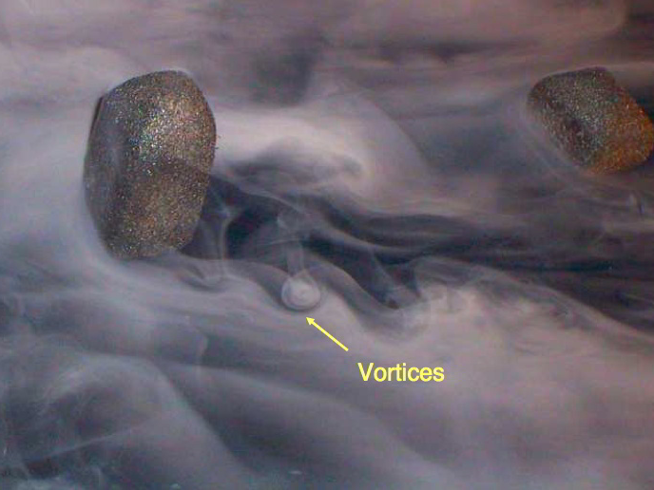
PHYS 8750 Numerical Fluid Dynamics
Fall, 2020
Turbulence illustration © 2003 André Bakker www.bakker.org

Slide 2
PHYS 8750
Outline
Atmospheric Models
Model types
Empirical models
Physics models
Data assimilative models
3. NRLMSIS and IRI
4. GSWM and CTMT
5. TIEGCM
Class #18, 19
Atmospheric
Models

Slide 3
Atmospheric Models
Empirical Models (data based, mathematical, statistical)
Good for climatology and background atmosphere
NRLMSIS, IRI, HWM
Physics Models (physical models)
Steady-state (external forcing or boundary condition)
GSWM, CTMT, Stationary Planetary Waves (week of Nov 17, 19)
Time-evolving (initial condition)
General circulation models (TIEGCM, CESM, KMCM, CTIPe)
Barotropic/baroclinic planetary wave model (week of Nov 17, 19)
Gravity wave models (MAGIC)
Data Assimilative Models
Underlying Physics models + data assimilation
WACCM-DART, ECMWF, MERRA

Slide 4
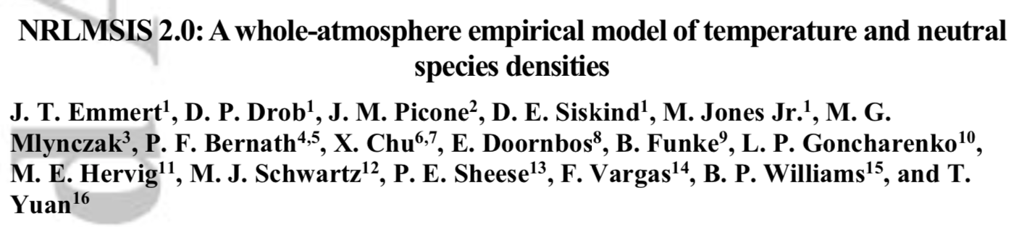
NRLMSIS
Naval Research Lab Mass Spectrometer Incoherent Scatter Model
NRLMSIS 2.0 is an empirical atmospheric model that extends from the ground to the exobase and describes the average observed behavior of temperature, 8 species densities, and mass density via a parametric analytic formulation. The model inputs are location, day of year, time of day, solar activity, and geomagnetic activity.

Slide 5
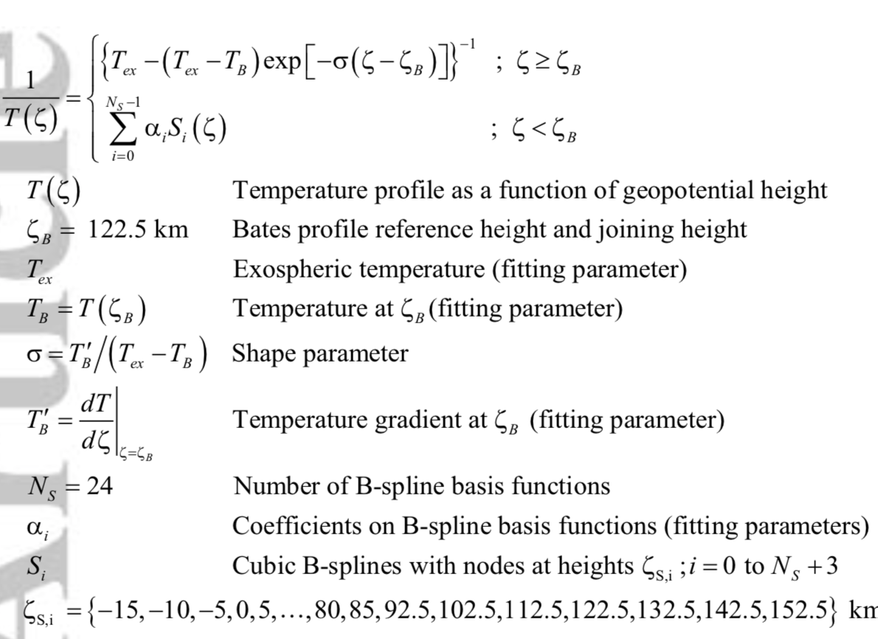
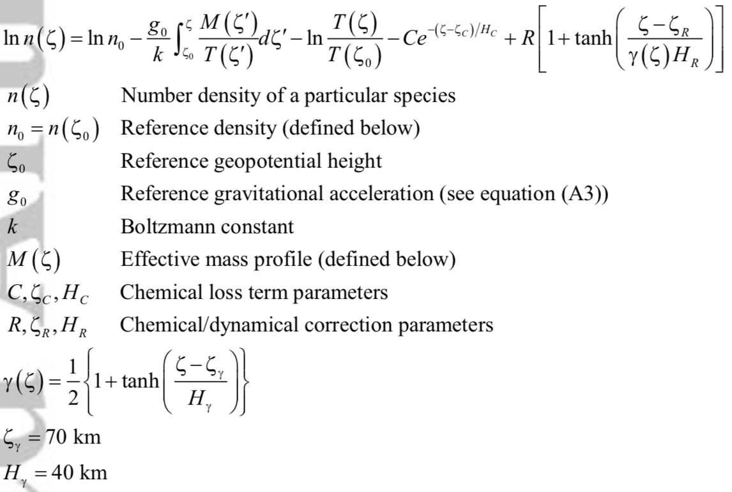
NRLMSIS
parametric analytic formulation + Fitting Using Data

Slide 6
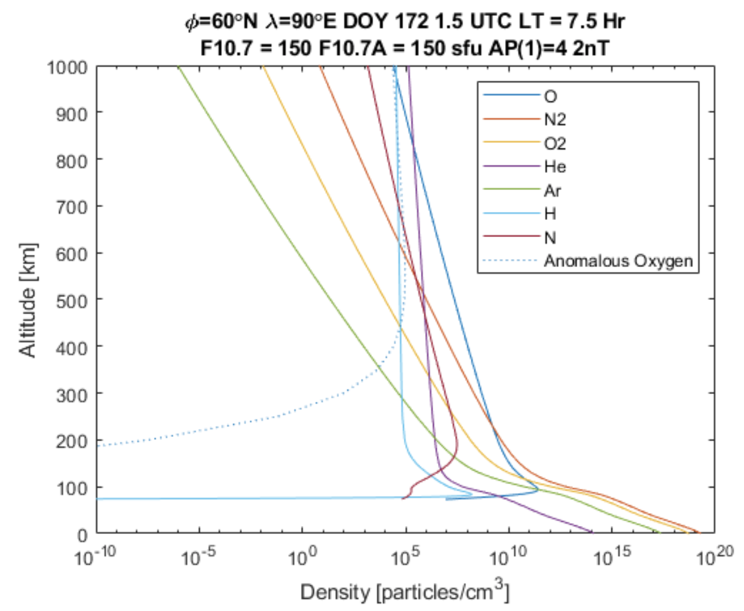
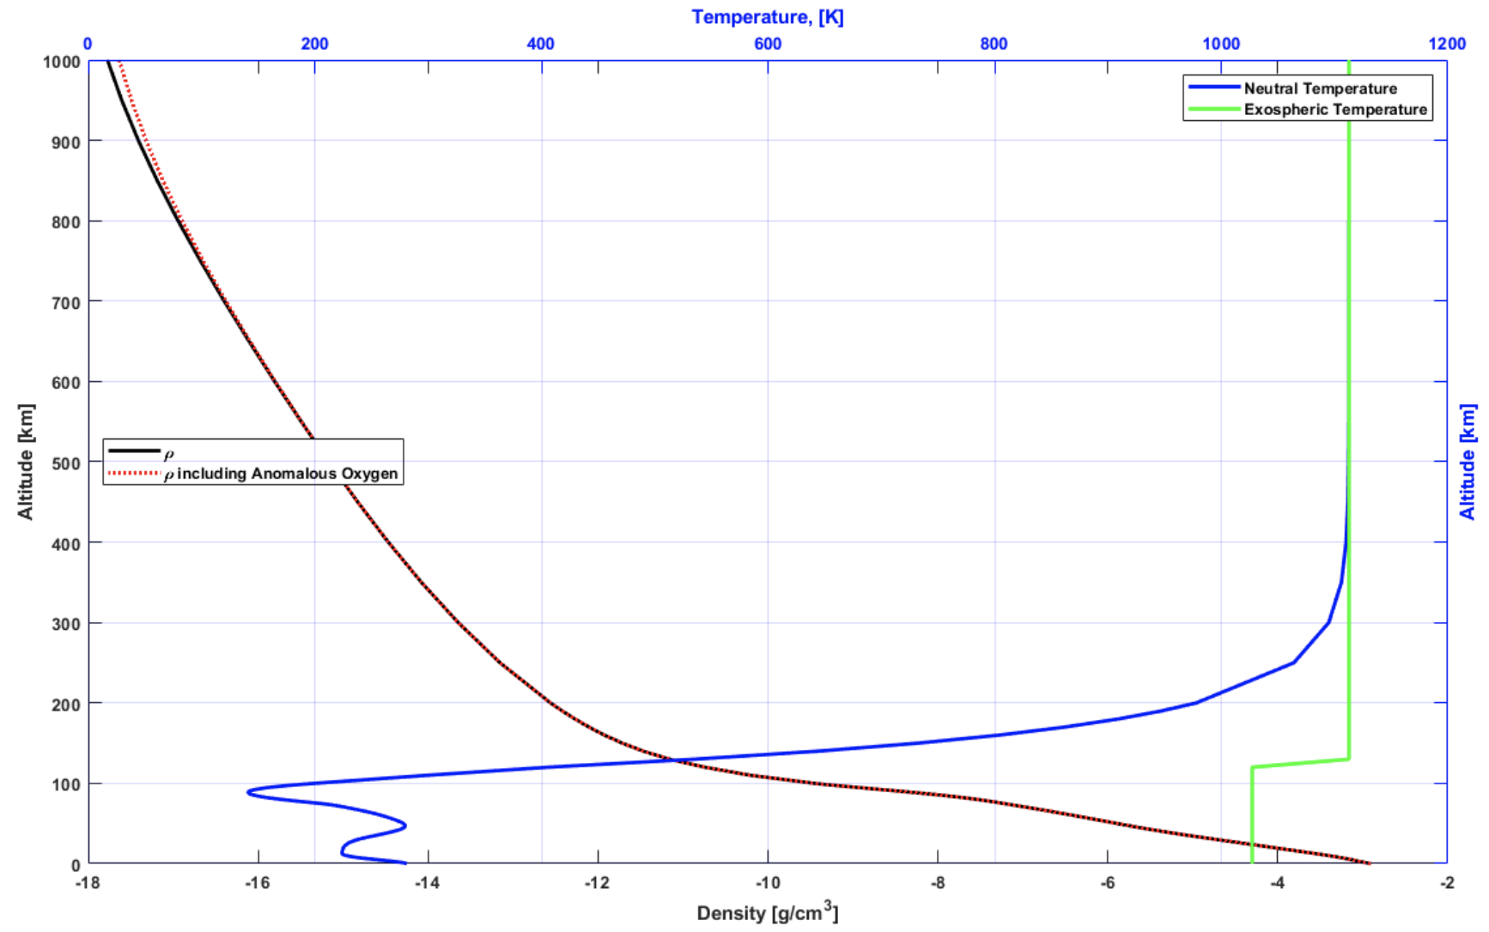
Outputs of NRLMSIS
Density of Species
Density & Temperature

Slide 7
IRI (International Reference Ionosphere)
The International Reference Ionosphere (IRI) is an international project sponsored by the Committee on Space Research (COSPAR) and the International Union of Radio Science (URSI).
PARAMETERS: Ne, Te, Ti, ion composition (O⁺, H⁺, He⁺, N⁺, NO⁺, O⁺₂, Cluster ions), equatorial VI, vertical TEC (vTEC), spread-F probability, auroral boundaries, effects of ionospheric storms on F and E peak densities.
INPUTS: Required: solar indices (F10.7), ionospheric index (ionosonde-based IG index 12-month running mean), magnetic index (ap).

Slide 8
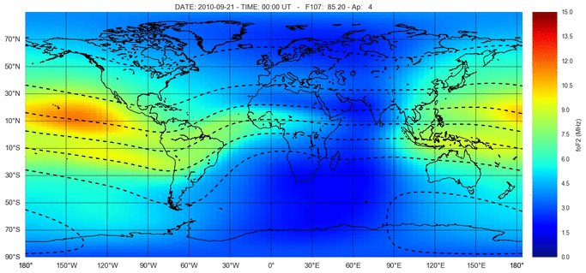
IRI Outputs

Slide 9
Physics Models
Steady-State
Mean values or waves amplitude do not change with time.
Large-scale Wave models
Tides: GSWM, CTMT
Planetary Waves: stationary wave model

Slide 10
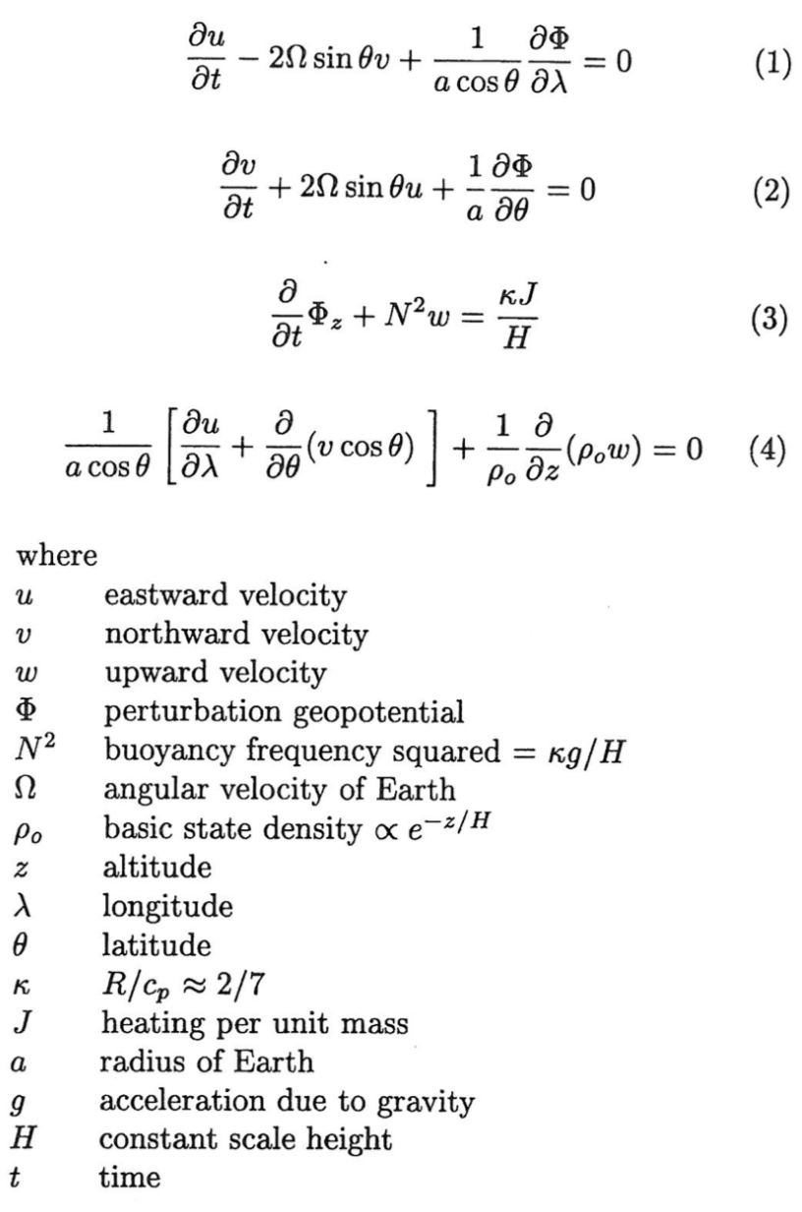
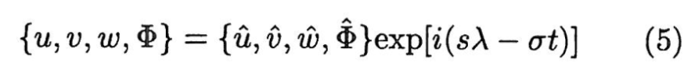
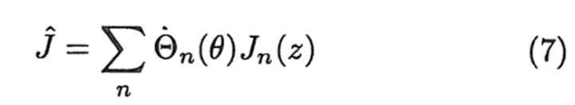
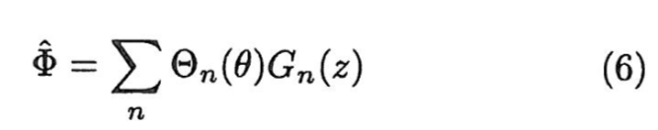
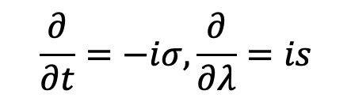
Global Scale Wave Model
By assuming the wave form
Then 4D problem becomes 2D
$$\frac{∂}{∂t}=−iσ,\frac{∂}{∂λ}=is$$
Separation of variable and solve for latitude and altitude directions
Forbes, 1995

Slide 11
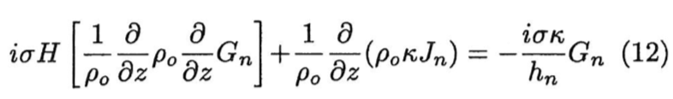
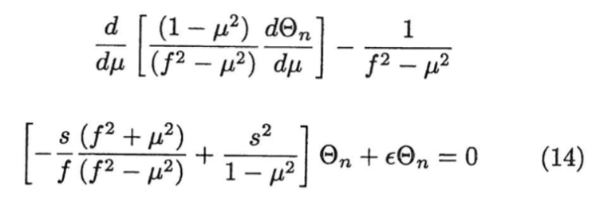
Global Scale Wave Model
Equation along altitude (z direction)
Equation along latitude (y direction)
For each tidal component, decompose heating term into different Hough modes, and solve for the tidal responses in different modes. The full solution is the superposition of all the Hough modes.

Slide 12
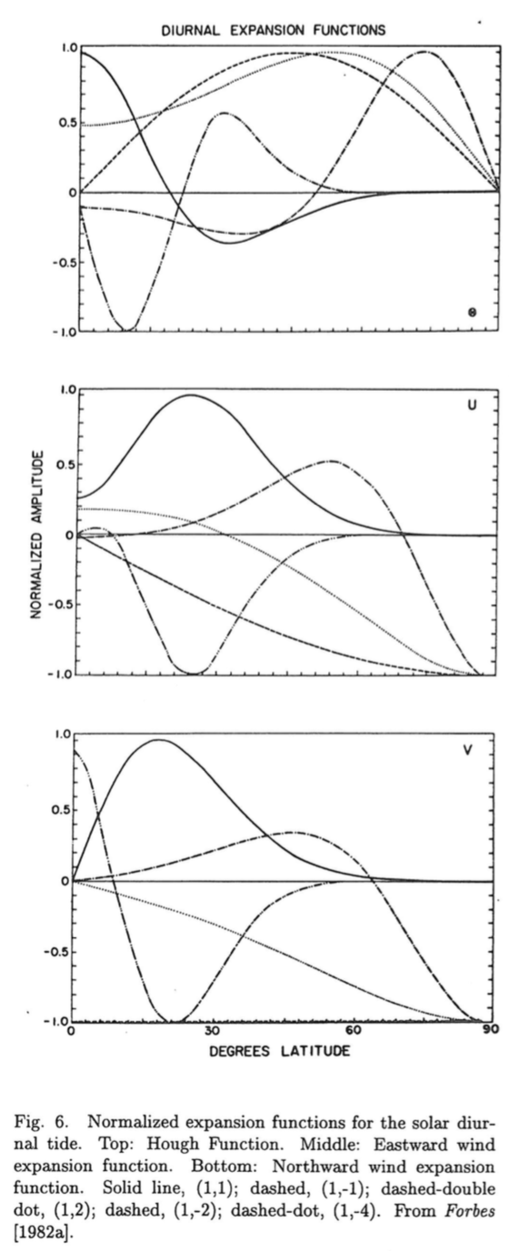
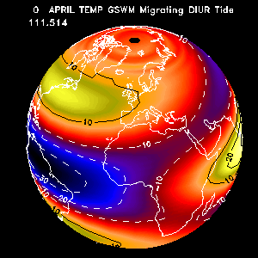
Global Scale Wave Model
Hough Modes
Temperature DW1
Forbes, 1995
Spherical coordinate: Legendre functions

Slide 13
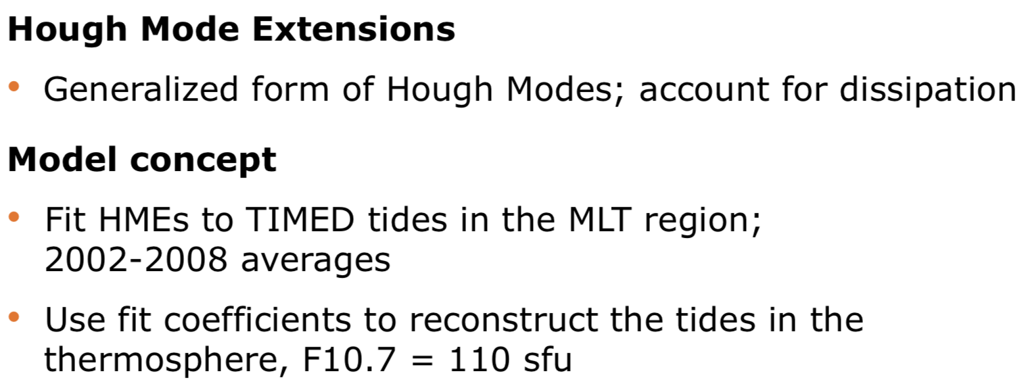
Climatological Tidal Model of the Thermosphere (CTMT)
Oberheide, J., J. M. Forbes, X. Zhang, and S. L. Bruinsma, Climatology of upward propagating diurnal and semidiurnal tides in the thermosphere, J. Geophys. Res., 116, A11306, doi:10.1029/2011JA016784, 2011.

Slide 14
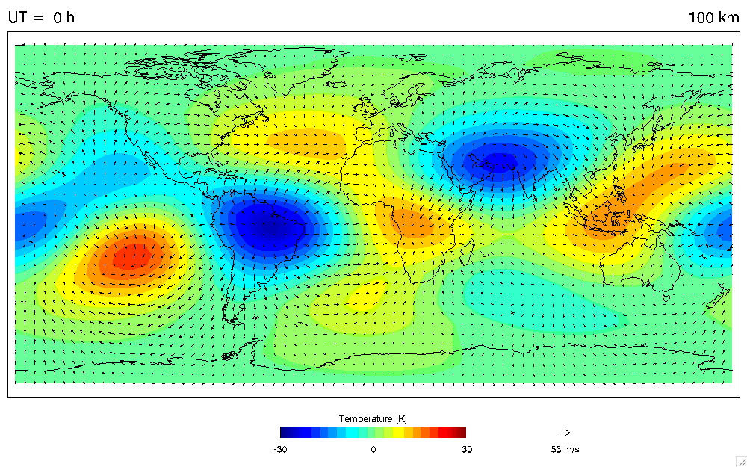
Climatological Tidal Model of the Thermosphere (CTMT)

Slide 15
TIEGCM (Thermosphere Ionosphere Electrodynamics General Circulation Model)

Slide 17
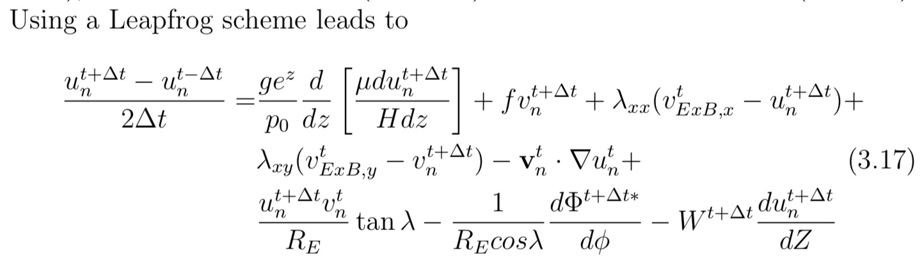
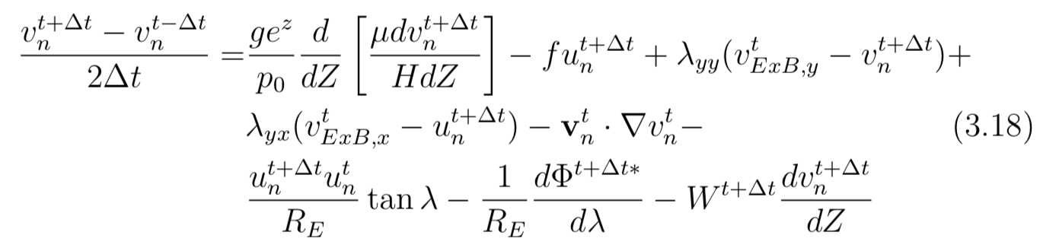
TIEGCM (Numerical Scheme Examples)
Zonal Momentum
Meridional Momentum

Slide 18
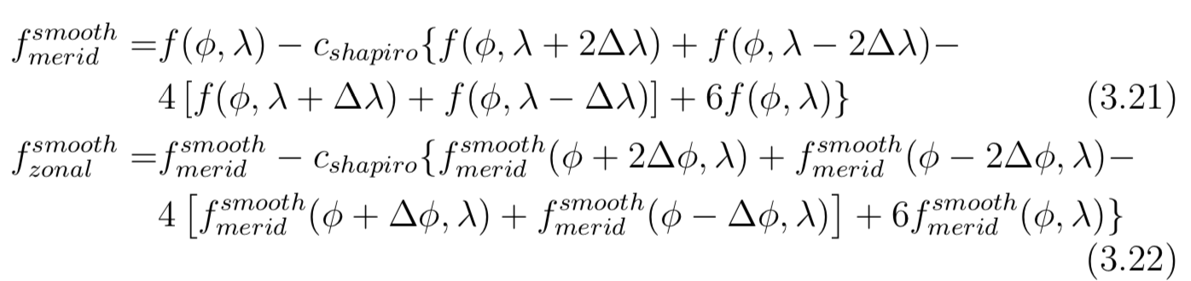
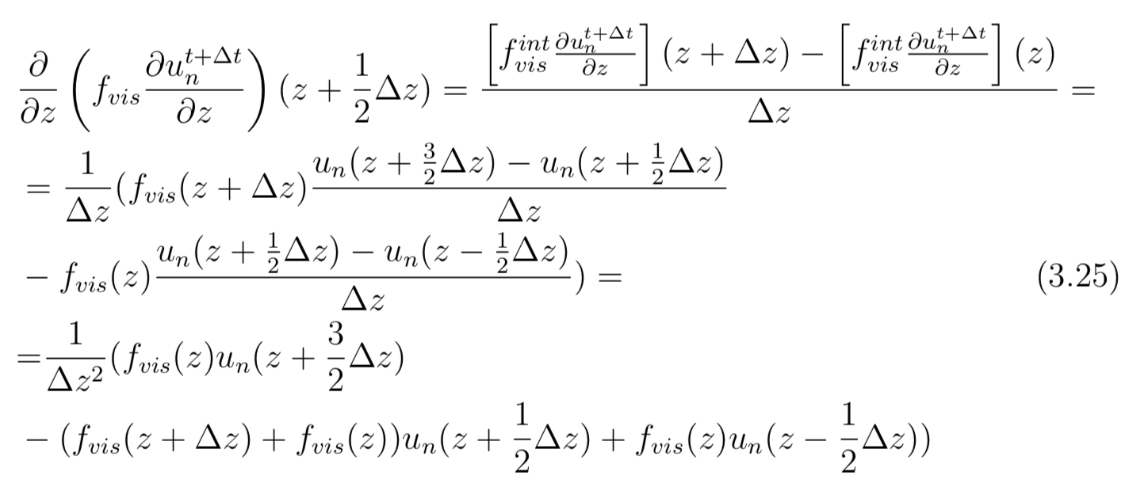
Spatial Filtering (Shapiro constant c = 0.3)
Vertical Direction (Diffusion)

Slide 19
TIEGCM Model Structure

Slide 20
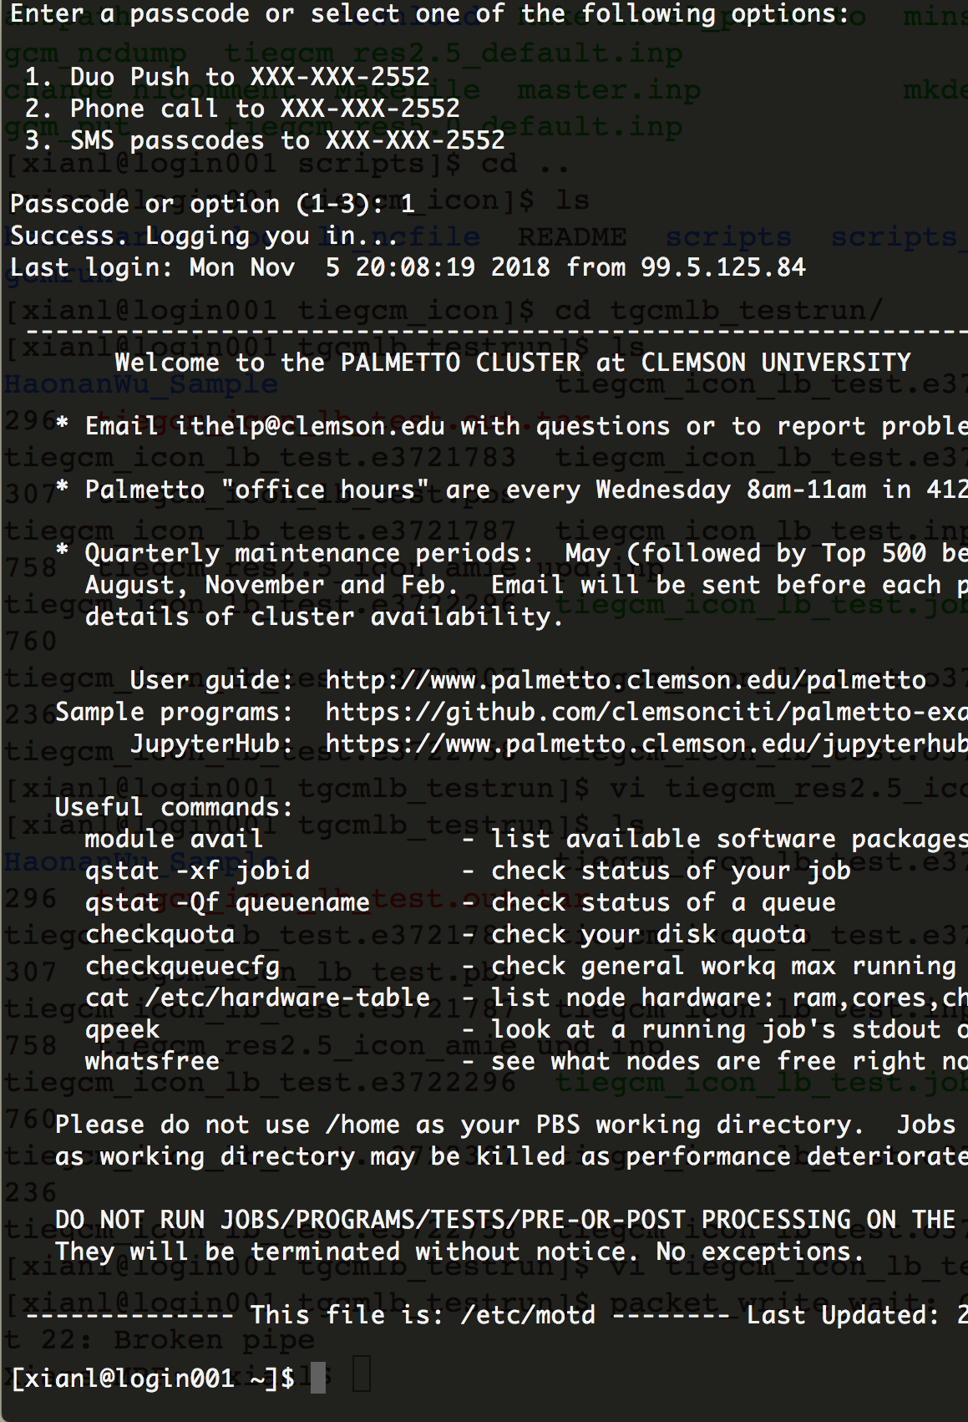
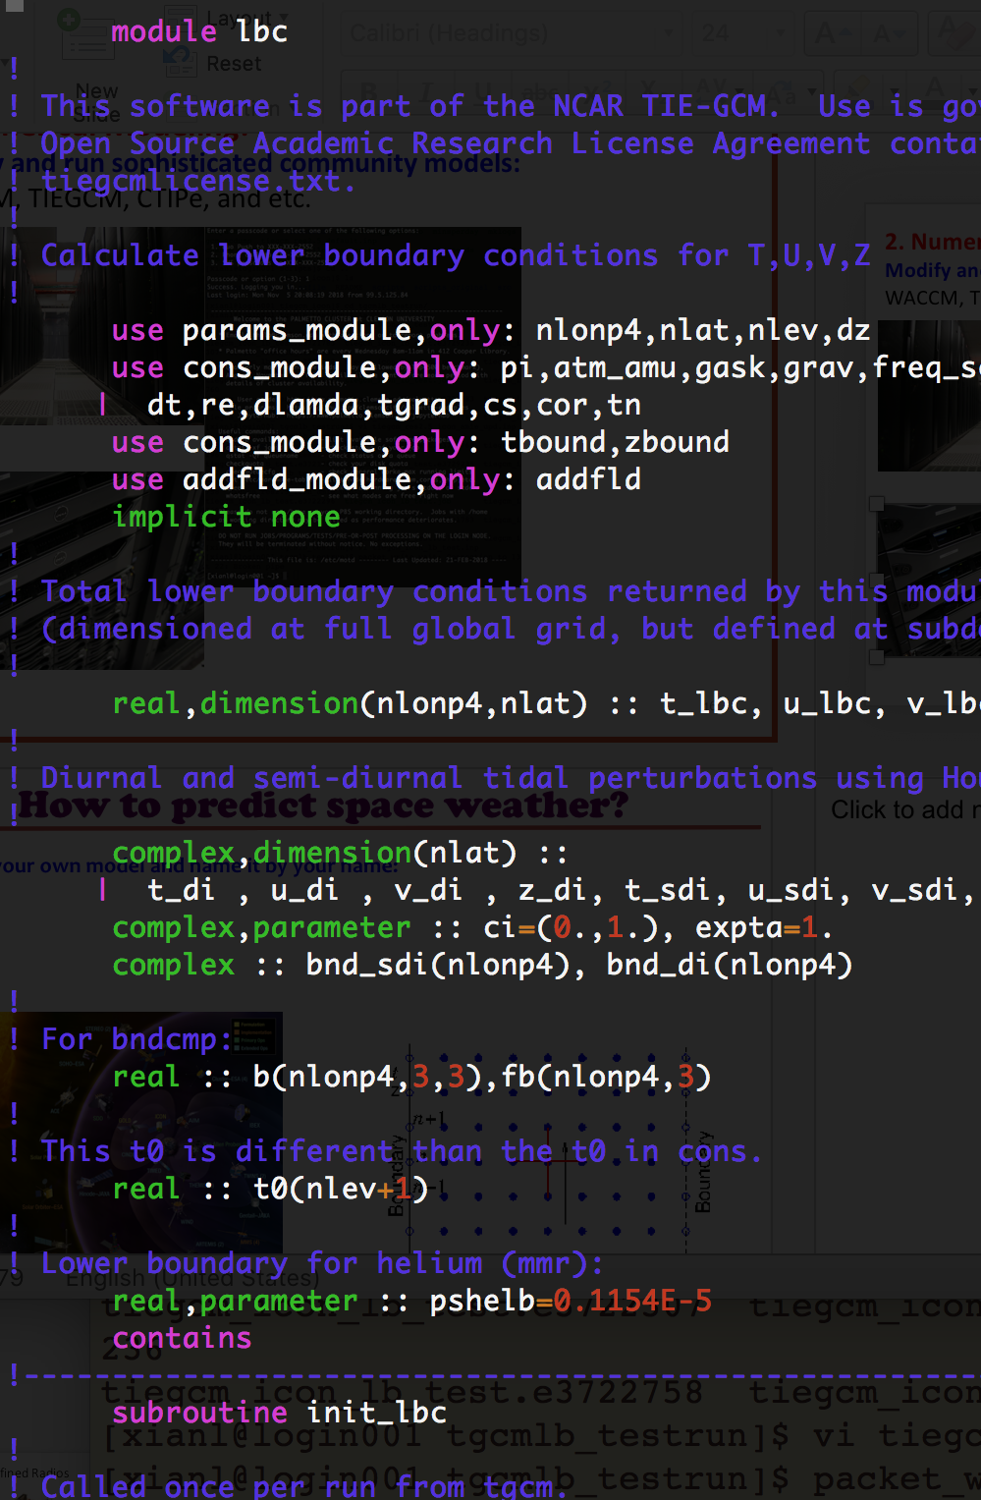
Palmetto Login Page
TIEGCM Code

Slide 21
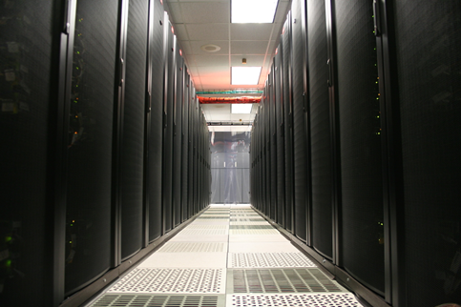
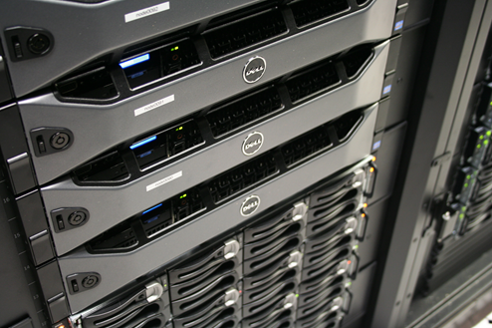
Clemson Palmetto Supercomputer
Community Models:
CESM
WACCM
TIEGCM,
TIMEGCM
Mechanistic Models:
Gravity Wave Planetary Wave

Slide 22
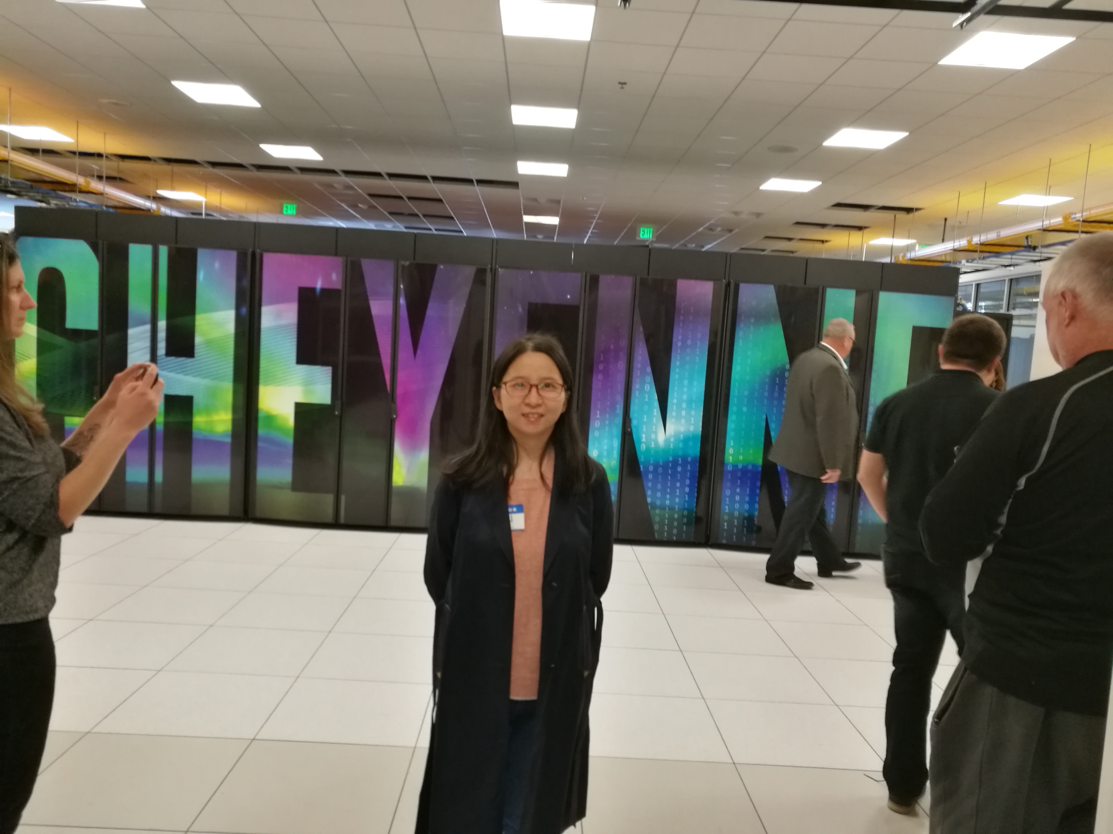
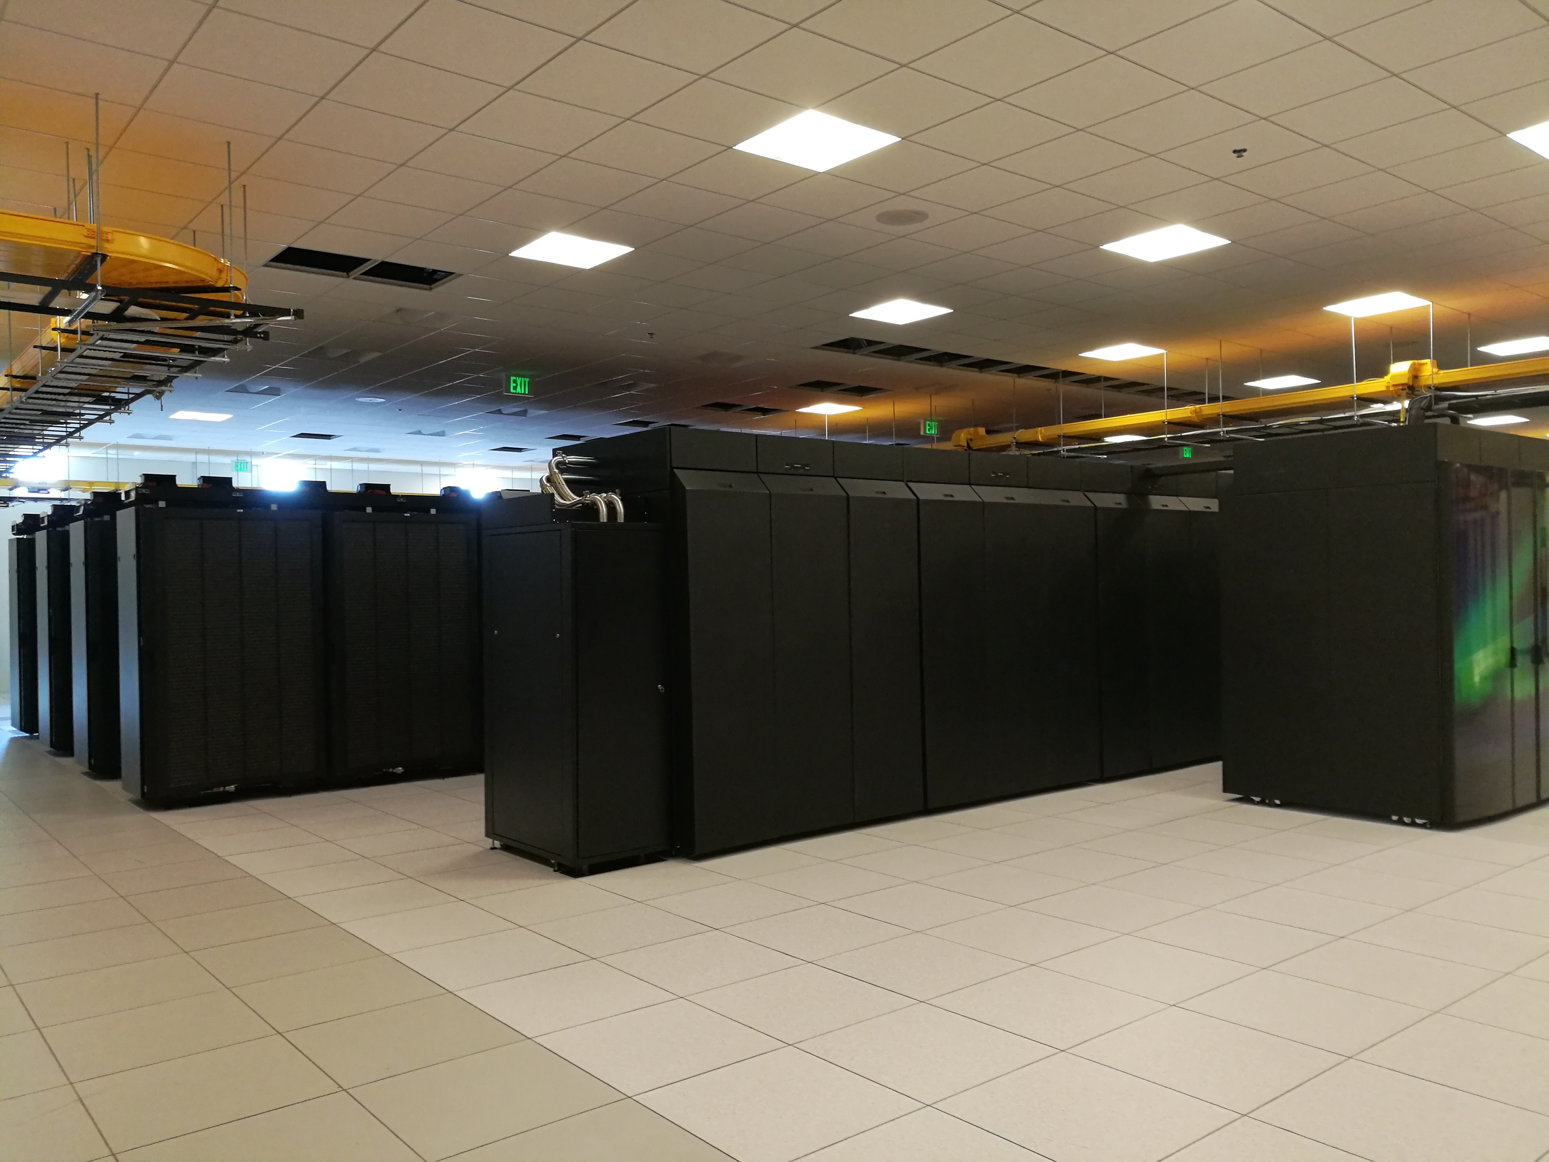
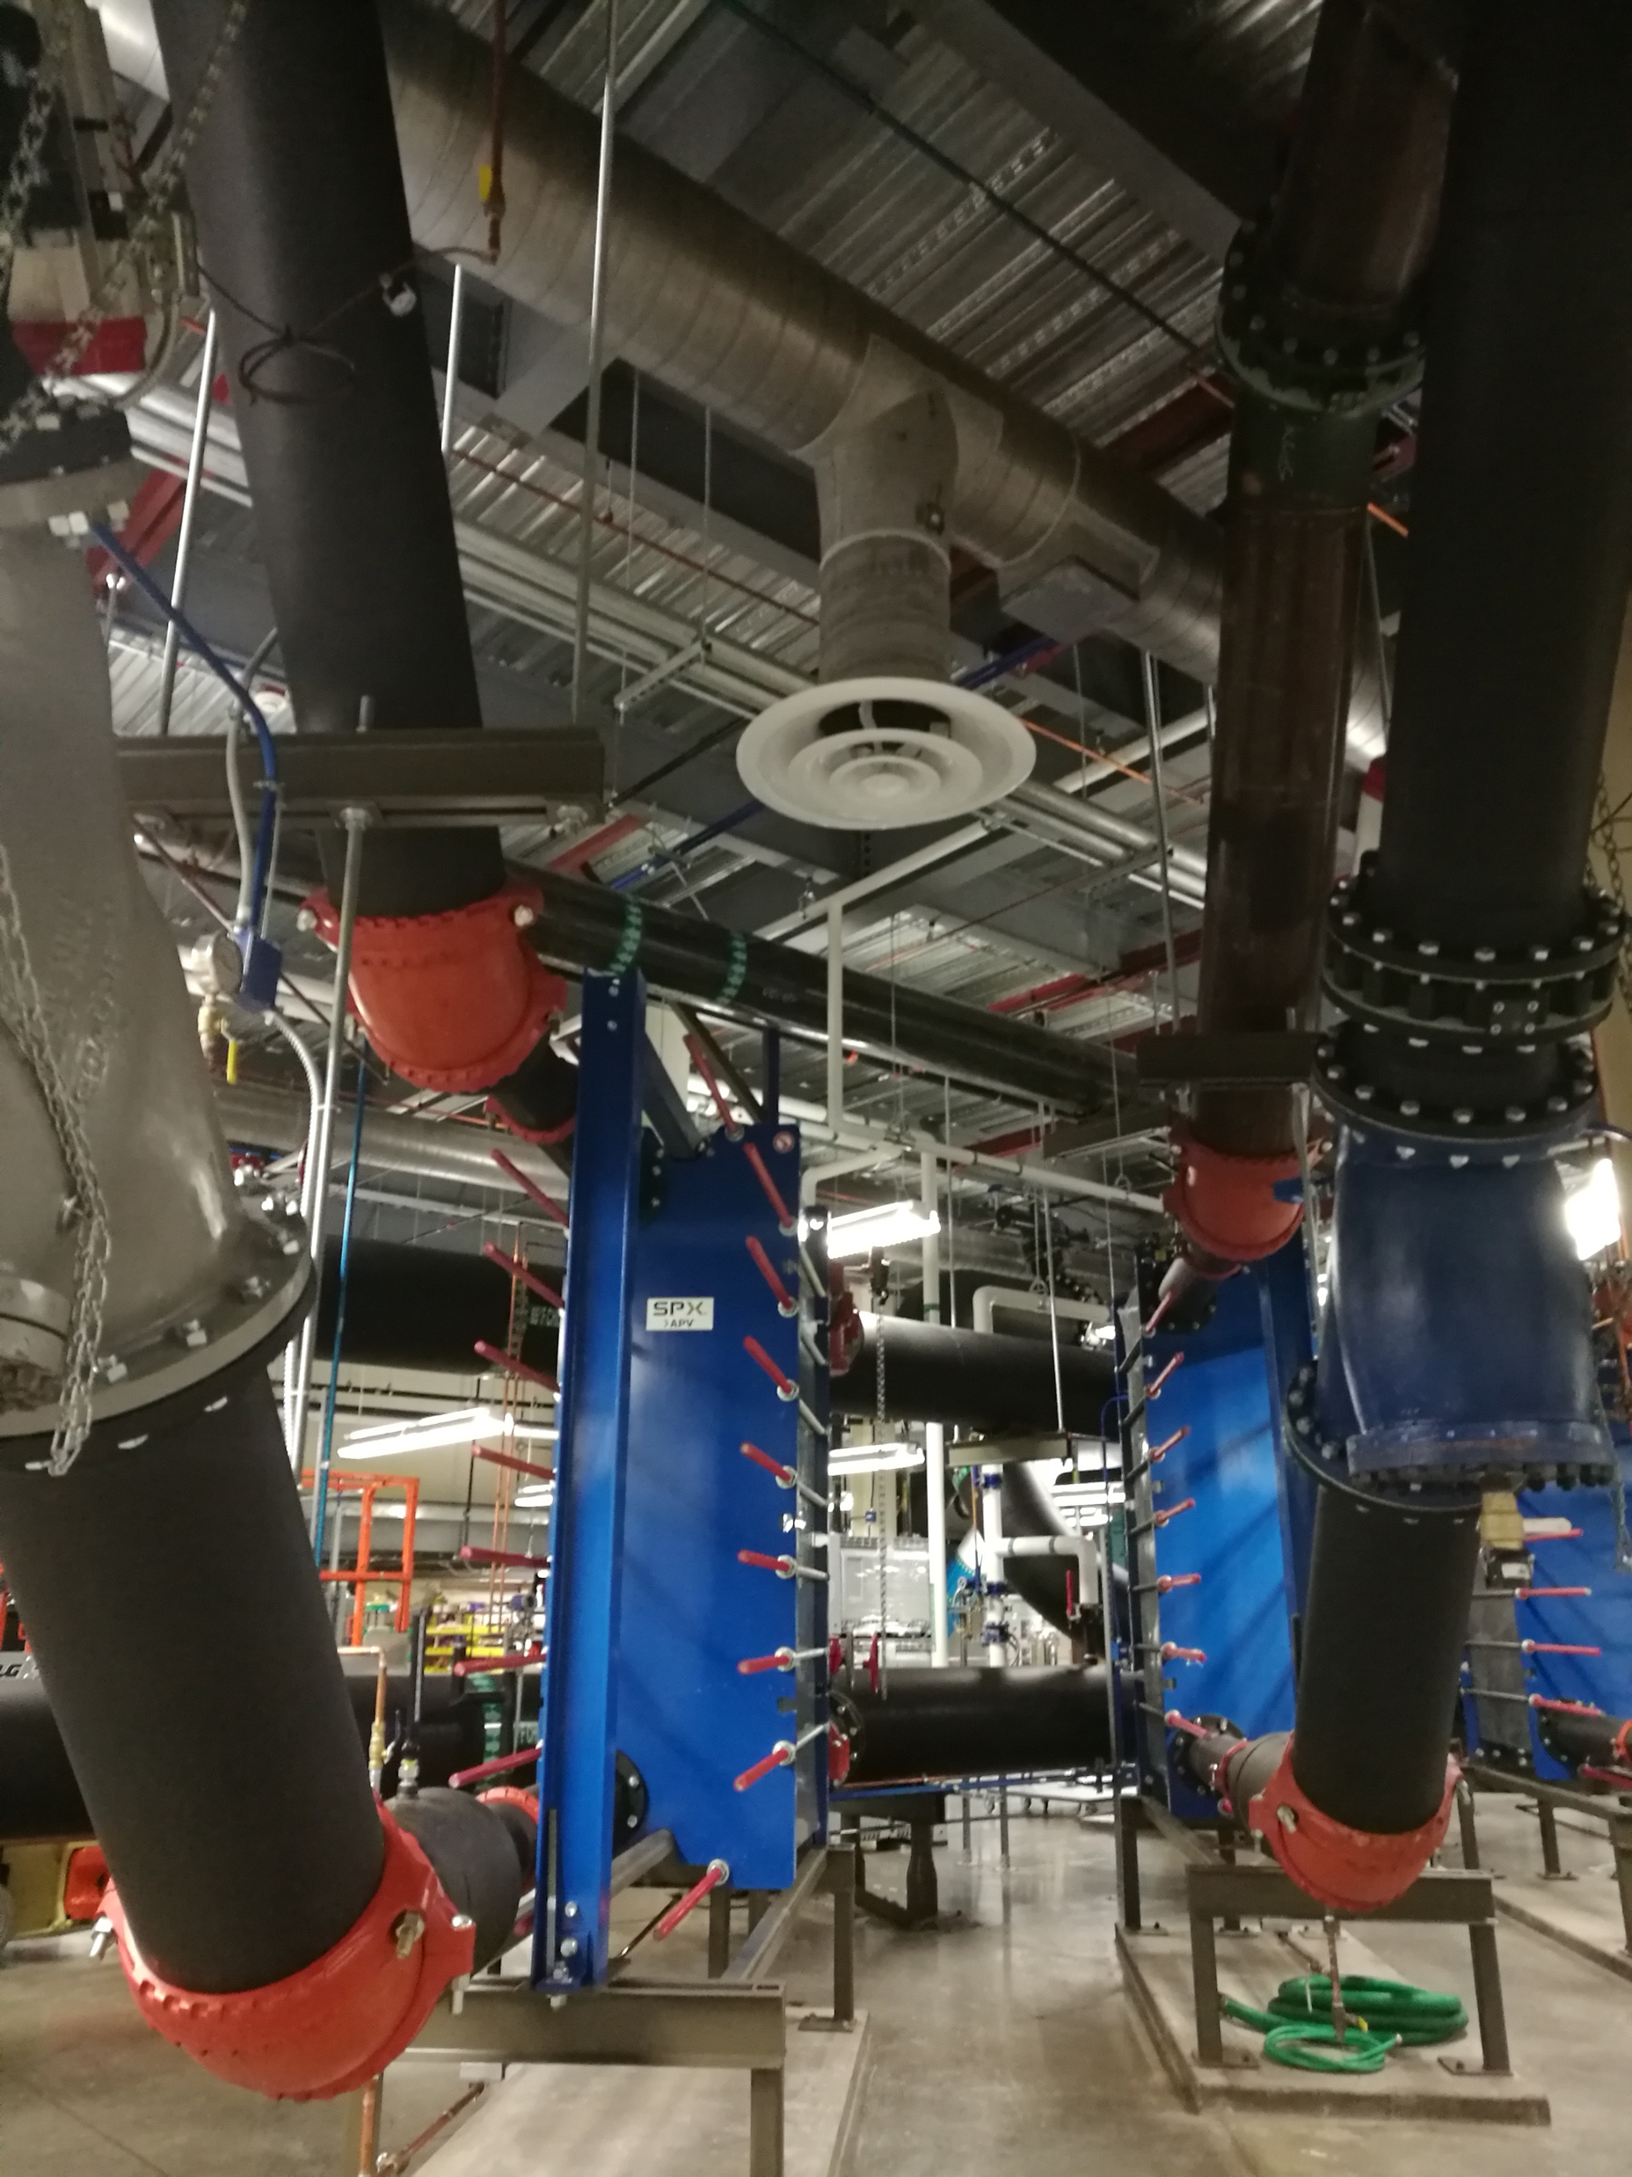
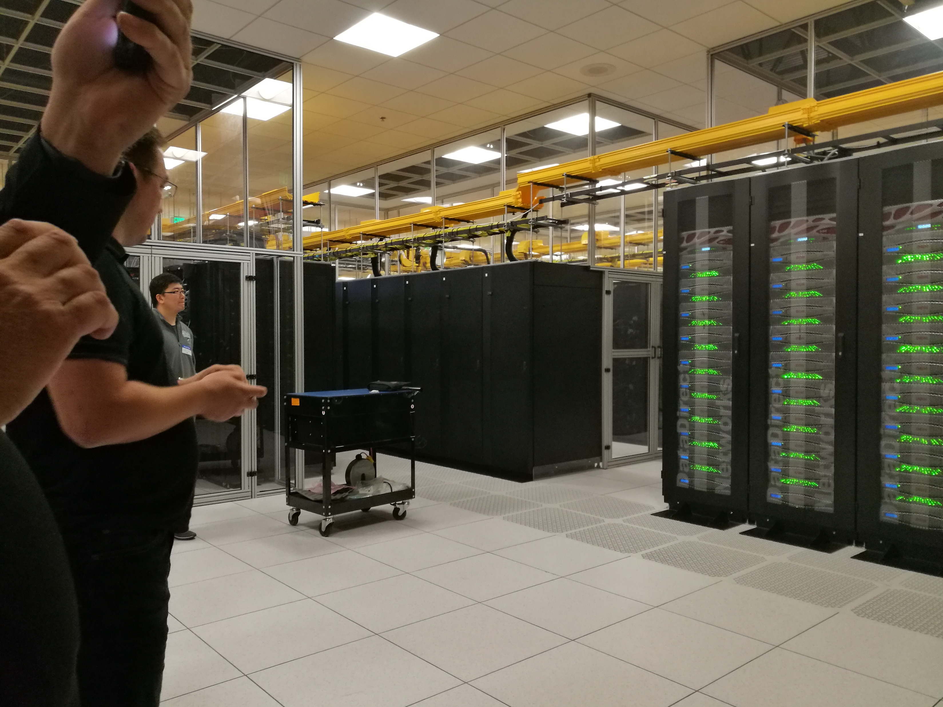
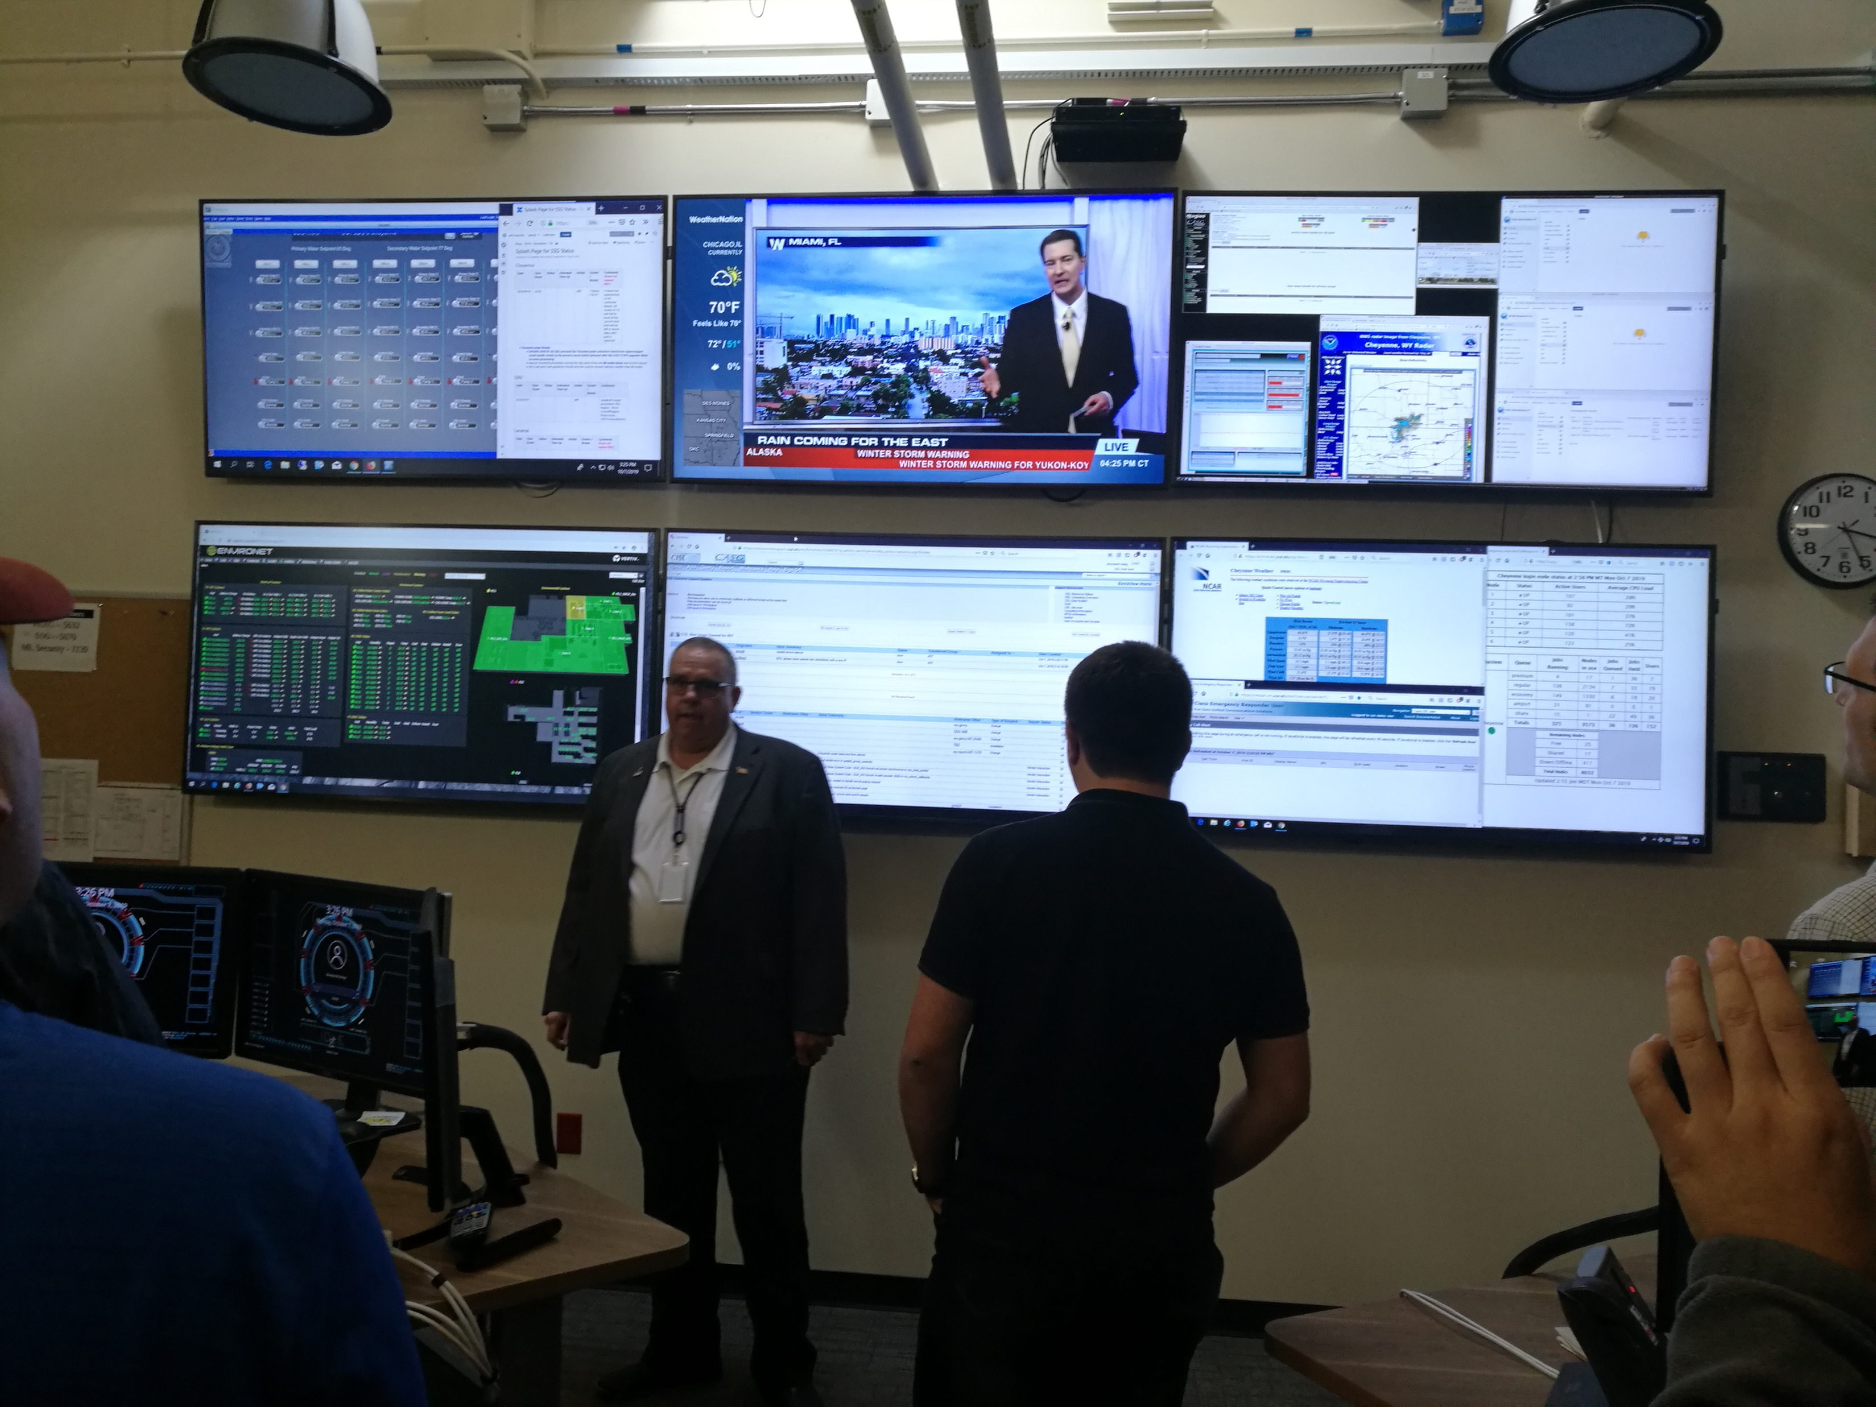
NCAR Cheyenne Supercomputer
Computing
Units
Cooling System
Storage
Units
Monitor
Room

Slide 23
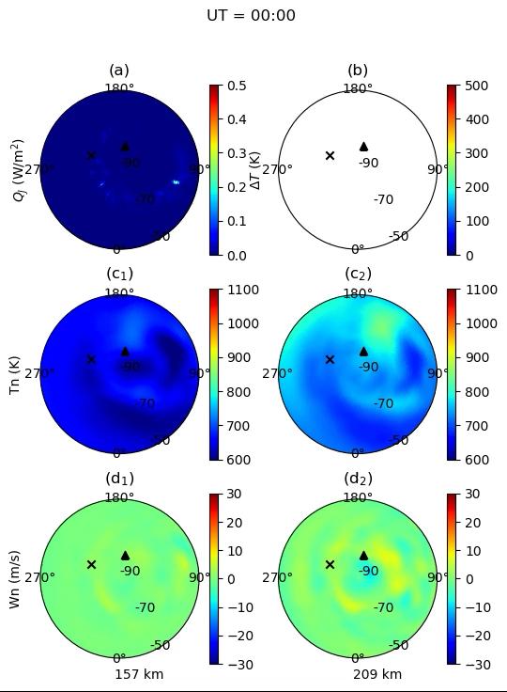
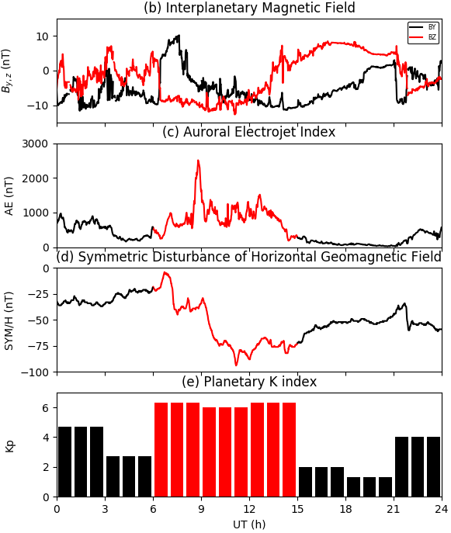
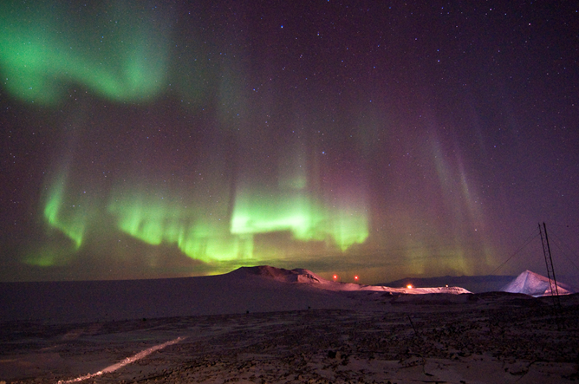
TIEGCM Simulation of
Space Storm
by Zhibin Yu

